Slide 1

Momentum Strategy

Slide 2
Introduction
The momentum strategy is a type of investment approach that relies on the idea that assets that have performed well in the past will continue to perform well in the future, and vice versa.
This strategy involves comparing the performance of an asset over different time frames to determine its trend.

Slide 3
Filters:
Filters are mathematical calculations or indicators used to smooth out price data and identify trends.
In the momentum strategy, we use two filters: a long-term filter and a short-term filter..

Slide 4
Long Tap VS Short Tap
This filter looks at the average price of the asset over a longer period, typically averaging over 200+ days.
It helps to identify the overall trend of the asset over a longer time frame.
This filter looks at the average price of the asset over a shorter period, typically averaging over 20+ days.
It helps to identify short-term fluctuations or changes in the trend of the asset.

Slide 5

The Trend
When the short-term filter is higher than the long-term filter, it indicates an uptrend. This means that the asset's price is generally rising.
When the short-term filter is lower than the long-term filter, it indicates a downtrend. This means that the asset's price is generally falling.

Slide 6
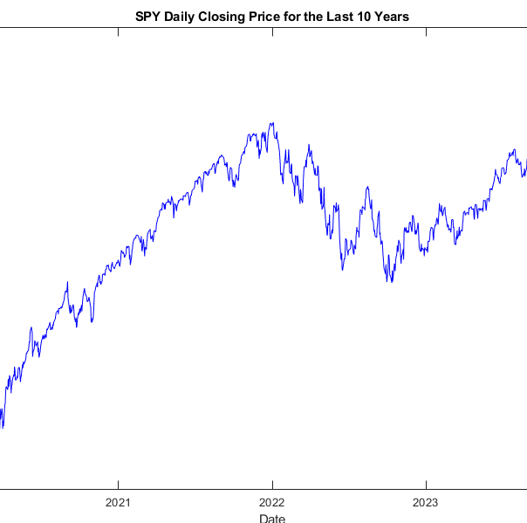
% Load the CSV file data = readtable('SPY.csv’); date = datenum(data.Date); closing_price = data.Close;

Slide 7

Loss prevention Strategy
The goal of this strategy is to protect your investment from losses during market downturns.
When the market is in a downtrend, meaning the short-term filter is lower than the long-term filter by a certain threshold, it suggests that the asset's price is likely to continue falling.
In this scenario, the strategy advises selling your holdings and holding cash instead of staying invested.
Once the market enters an uptrend again, indicating that the short-term filter is higher than the long-term filter, it suggests that the asset's price is likely to rise.
At this point, the strategy advises buying back into the asset to benefit from potential gains.

Slide 8
The NEW signal
We're going to use two types of moving average filters: one for the long-term trend and another for the short-term trend.
Long-Term Filter:
Imagine looking at the average price of a stock over a long period, like a year. This gives us an idea of the general trend over the long haul. We'll create a filter that calculates the average price over 300 days. This will be our long-term filter.
Short-Term Filter:
Now, picture zooming in a bit and looking at the average price of the stock over a shorter period, like a month. This helps us see short-term fluctuations. We'll create a filter that calculates the average price over 50 days. This will be our short-term filter.
Applying Filters:
We'll use these filters on the daily closing prices of SPY for the last 10 years. The long-term filter helps us see the general trend over the 10-year period, while the short-term filter helps us see shorter trends within that period.
Creating a Momentum Signal:
Now, we'll subtract the output of the long-term filter from the output of the short-term filter. This gives us a single number that represents the momentum of the stock at any given time. If it's positive, it means the short-term trend is stronger than the long-term trend, suggesting potential buying opportunity. If it's negative, it means the short-term trend is weaker than the long-term trend, suggesting potential selling opportunity.

Slide 9
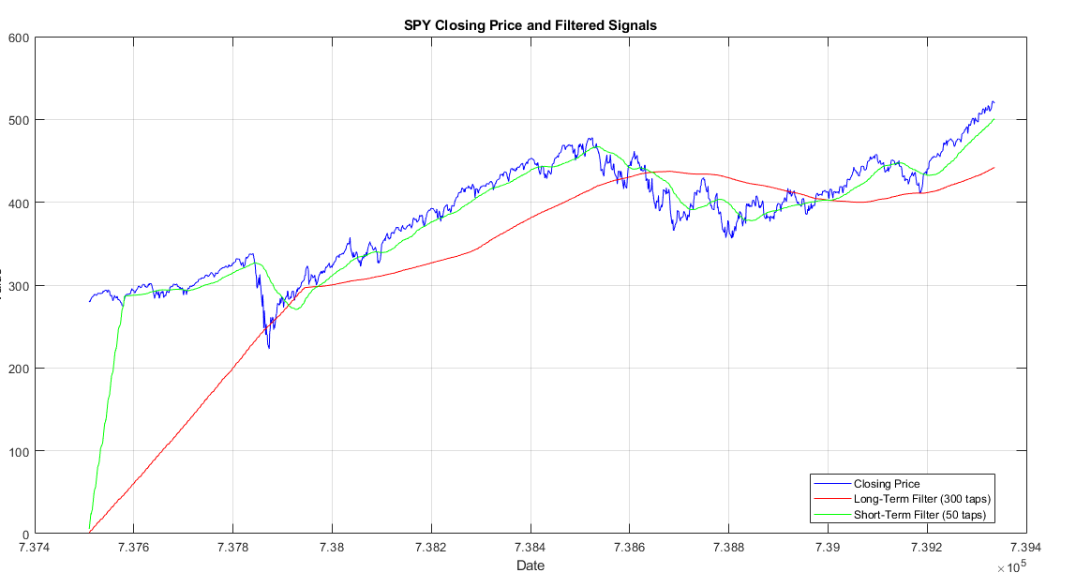
Questions?
Once the market enters an uptrend again, indicating that the short-term filter is higher than the long-term filter, it suggests that the asset's price is likely to rise.

Slide 10
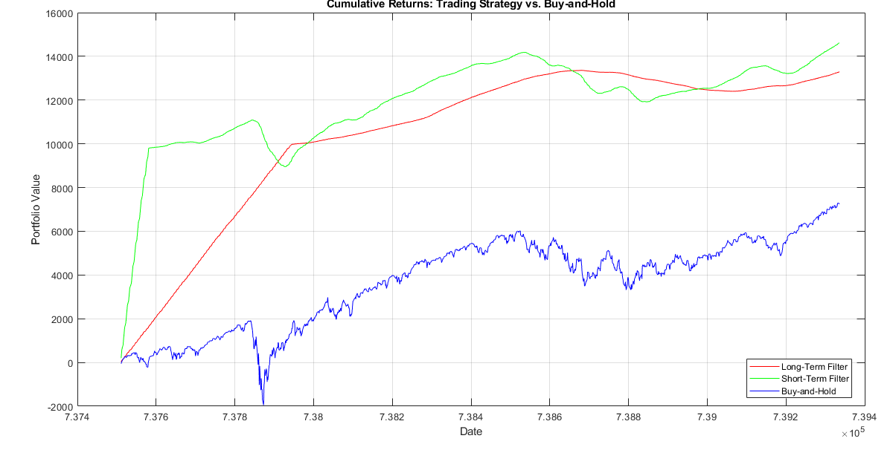

Slide 11
Calculating Returns:
returns_long = diff(y_filtered_long) ./ closing_price(1:end-1);
returns_short = diff(y_filtered_short) ./ closing_price(1:end-1);
returns_buy_hold = diff(closing_price) ./ closing_price(1:end-1); cumulative_returns_long = cumsum(returns_long) * initial_investment; cumulative_returns_short = cumsum(returns_short) * initial_investment; cumulative_returns_buy_hold = cumsum(returns_buy_hold) * initial_invest

